Slide 1
UNIT – 03
The UX Design Process-
Understand
Users

Slide 2
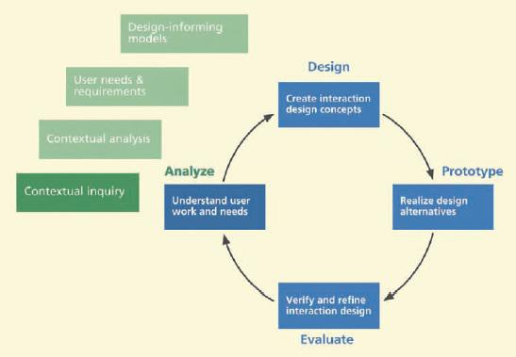

Slide 3
Some Important Definitions
1) Work
Work is the set of activities that people undertake to
accomplish goals.
system or product
Some of
usage.
these activities involve
2) Work Domain
The entire context
of work
and
work practice in the
usage environment.
target enterprise or other target

Slide 4
3) Work Practice
Work practice is the pattern of established actions, approaches, routines, conventions, and procedures followed and observed in the customary performance
of a particular job
enterprise.
to carry out the operations of an
2) Work Activity
A work activity is
comprised of sensory , cognitive,
and physical actions made by users in the course of
carrying out the work practice.

Slide 5
5) Contextual Inquiry
•
Contextual inquiry is an early system or product
UX lifecycle activity to gather detailed descriptions
of customer or user work practice for the purpose of understanding work activities and underlying rationale.
The goal of contextual inquiry is to improve work practice and construct and/or improve system designs to support it.
Contextual inquiry includes both interviews of customers and users and observations of work practice occurring in its real-world context.
•
•

Slide 6
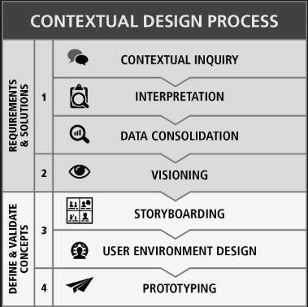

Slide 7
1.2 A True Story
----Story----
So what does this have to do with contextual inquiry?
If you do contextual inquiry in a real environment like this, you might get lucky and find rich user data.
• It is certain however that, if you do not do
contextual inquiry, you will never
information about situated usage.
get
this
kind
of

Slide 8
1.3 Understanding Other People’s Work Practice
• Contextual inquiry has taken on importance in the
UX process.
It takes real effort to learn about other people’s work, which is usually unfamiliar, especially the details.
6) Task Analysis -
and deconstruction
of representing the
Task analysis is the investigation
of units of work. It is the process
structure of these units plus
describing how they are performed, including goals,
steps, and actions.

Slide 9
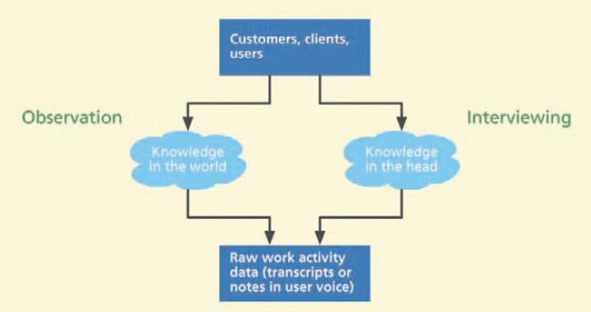
1.4 Not the Same as Task Analysis or a Marketing
Survey
1.5 The Concepts of Work, Work Practice, and
Work Domain
1.6 Observing and Interviewing
in
Situ:
What
They
Say
vs.
What
They
Do

Slide 10
2.
The System Concept
Statement

Slide 11
•
A system concept statement is a concise descriptive
summary of the envisioned system or product
stating an initial system vision or mandate;
it is a mission statement for the project.
in short,
•
A system (or product) concept statement is
all starts, even before contextual inquiry.
where it
•
Before a UX team can conduct contextual inquiry,
which will lead to requirements and design for the envisioned system, there has to be a system concept.

Slide 12
Points To Remember :
▪ A system concept statement is typically 100 to 150 words
in length.
▪ It is a mission statement for a system to explain it to outsiders and to help set focus and scope for system development internally.
▪ Writing a good system concept statement is not easy.
▪ The amount of attention given per word is high. A system concept statement is not just written; it is iterated and refined to make it as clear and specific as possible.

Slide 13
An effective system concept statement answers at
least the following questions:
▪ What is the system name?
▪ Who are the system users? What will the system do?
▪ What problem(s) will the system solve? (You need to be
broad here to include business objectives.)
▪ What is the design vision and what are the emotional impact goals? In other words, what experience will the system provide to the user? This factor is especially important if the system is a commercial product.

Slide 14
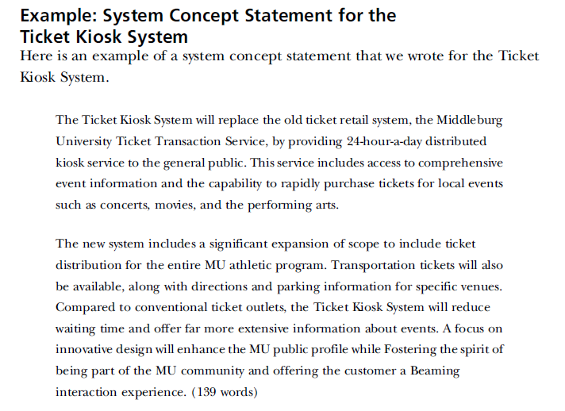

Slide 15
Upon interacting with the customers and users, some
of our objectives in this system concept statement
will
be
adjusted
and
assumptions
will
be
corrected.

Slide 16
3.
User
Work Activity
Gathering
Data

Slide 17
To do your user work activity data gathering you will:
▪ Prepare and conduct field visits to the customer/user work
environment, where the system being designed will be used.
▪ Observe and interview users while they work.
▪ Inquire into the structure of the users’ own work practice
▪ Learn about how people do the work your system is to be designed to support
▪ Take copious, detailed notes, raw user work activity data,
on the observations and interviews

Slide 18
3.1 Before the Visit: Preparation for the Domain-Complex
System Perspective
▪
▪
▪
▪
▪
▪
▪
▪
▪
▪
▪
Learn about your customer organization before the visit
Learn about the domain
Issues about your team
Lining up the right customer and user people
Get access to “key” people
What if you cannot find real users?
Setting up the right conditions How many interviewees at a time? Preparing your initial questions
Before the visit: Preparation for the product perspective
Anticipating modeling needs in contextual inquiry: Create contextual data “bins”

Slide 19
7) Data Bin - a temporary repository—for example,
a labeled pile of notes on a table—to hold data—raw
contextual data
notes. Each bin
at first and, later, synthesized work activity
corresponds
topic.
to
a
different
data
category
or
contextual
data

Slide 20
3.2 During the Visit: Collecting User Work Activity
Data
in the Domain-Complex System
▪ When you first arrive
▪ Remember the goal
▪ Establish trust and rapport
▪ Form partnerships with users
▪ Task data from observation and
▪ Recording video
▪ Note taking
Perspective
interview
▪ Use a numbering system to identify each point in data

Slide 21
▪
•
How to proceed
Be a listener; in most cases you should not offer your opinions about what users might need.
Do not lead the user or introduce your own perspectives.
Do not expect every user to have the same view of the
work domain and the work; ask questions about the
differences and find ways to combine to get the “truth.”
Capture the details as they occur; do not wait and try to
remember it later.
Be an effective data detective. Follow leads and discover, extract, “tease out” and collect “clues.” Be ready to adapt, modify, explore, and branch out.
•
•
•
•

Slide 22
▪ Pay attention to information needs of users
▪ What about design ideas that crop up?
▪ What about analyst and designer ideas that crop up?
▪ Questions not to ask
• Do not ask about the future
• Do not ask for design advice, how they would design a given feature
• Do not ask a question by trying to state what you think is
their rationale.

Slide 23
▪
•
Other forms of data collection
Copious digital pictures of the physical environment, devices, people at work, and anything else to convey work activities and context visually
On-the-fly diagrams of workflow, roles, and relationships
On-the-fly sketches of the physical layout, floor plans (not necessary to be to scale), locations of people, furniture, equipment, communications connections, etc.
Quantitative data—for example, how many people do this job, how long do they typically work before getting a break, or how many widgets per hour do they assemble on the average?
•
•
•

Slide 24
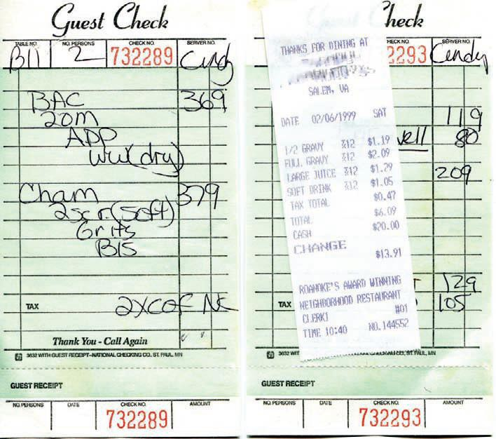
▪ Collect work artifacts
• a set of paper work artifacts, including manually created
order
forms
and
“guest
checks,”
from
a
local
restaurant

Slide 25
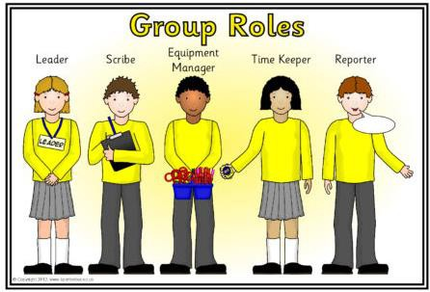
3.3 During the Visit: Collecting User Work Activity
Data in the Product Perspective
▪ Roles of users will be different with commercial products.
▪ In most cases, work in a domain-complex system context is
performed by people in
roles that make up the
organization,
which
we
will
be
calling
“work
roles”

Slide 26
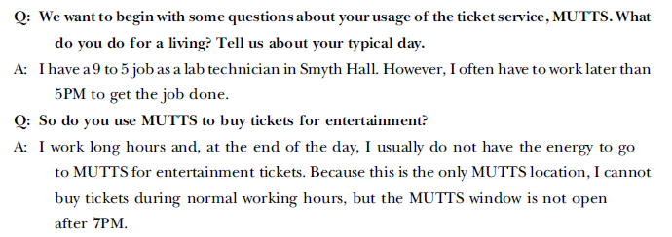
Example: User Data Gathering for MUTTS
▪ There is contextual inquiry sessions, interviewing MUTTS
employees and customers.
▪ Where three analysts separately interviewing several
groups of one or two users at a time and
came
up
with
a
fairly
rich
set
of
raw
data
transcripts.

Slide 27
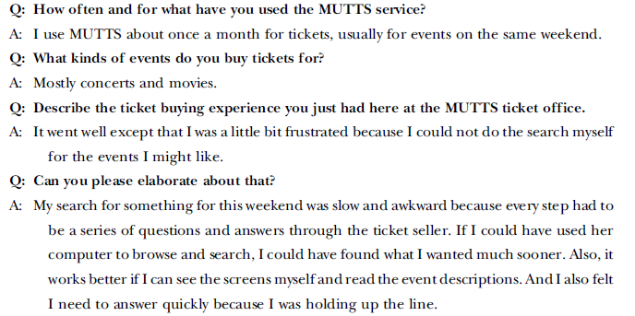

Slide 28
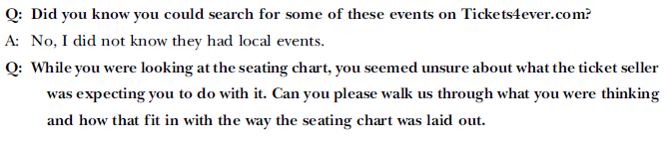
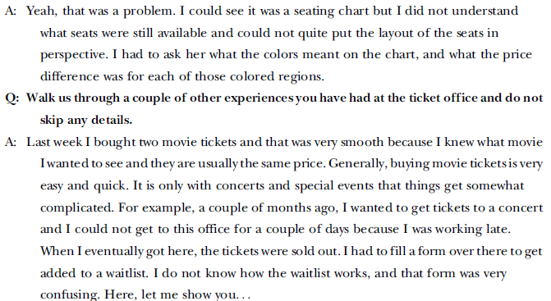

Slide 29
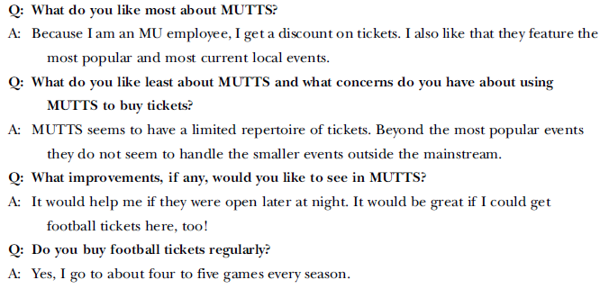

Slide 30
4. Look
For Emotional
Aspects
Of
Work
Practice

Slide 31
Points To Remember:
▪ Look for the impact of aesthetics and fun in work practice,
and look for opportunities for more of the same.
▪ You must try harder to uncover an understanding about emotional and social aspects of work practice.
▪ Look for ways to fight job boredom
– What about the work is boring?
– What are they doing when they have fun?
– Where can job stress be relived with aesthetics & fun?
– What parts of usage are learned over longer times?

Slide 32
5. Abridged
Inquiry
Contextual
Process

Slide 33
Points To Remember:
▪ Minimize overlap in raw data collection across interviews.
▪ Use your experience to focus on just the essentials.
▪ Another way to abridge your contextual inquiry is to limit your scope and rigor
▪ One of the most obvious and direct ways to abridge the full contextual inquiry process to save resources is to not make audio or video recordings of the user interview sessions.

Slide 34
6. Data-driven
Vs.
Model-driven
Inquiry

Slide 35
Data-driven Inquiry :
▪
Data-driven contextual inquiry results in voluminous raw
data describing a wide variety of topics.
To digest this mass of disparate data points, make sense of them, and put these data to work in informing design, practitioners must apply contextual analysis to extract the concise and meaningful points and issues and then sort and organize them into affinity diagrams.
Then the sorted categories must be converted into design informing models such as flow models, user models, and task models.
▪
▪

Slide 36
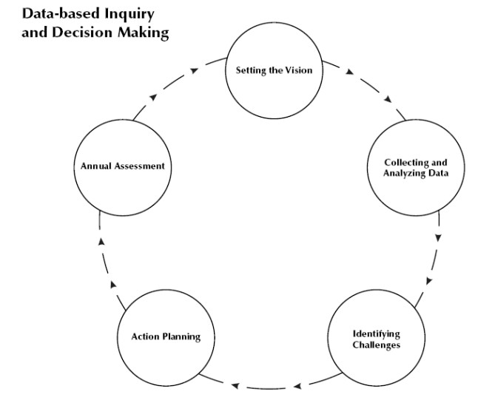

Slide 37
Model-driven Inquiry :
▪ Model-driven inquiry is based in exploratory modeling
development.
▪ The approach has evolved through practice on multiple projects into a streamlined and simplified agile alternative to conventional ethnographic approaches.
▪ In outline, model-driven inquiry is straight forward:
– Build exploratory models
– Compile emerging questions or issues
– Select expeditious means for resolution
– Conduct limited, highly focused inquiry
– Refine and complete the initial models
– Review and validate the models

Slide 38
7.
History

Slide 39
▪ 7.1 Roots in Activity Theory
▪ 7.2 Roots in Ethnography
▪ 7.3 Getting Contextual Studies into HCI
▪ 7.4 Connections to Participatory Design

Slide 40
8.
Contextual
Analysis

Slide 41
Contextual analysis is the systematic analysis—
identification, sorting,organization,interpretation,
consolidation, and communication—of the contextual user work activity data gathered in contextual inquiry, for the
purpose of understanding
the
work
context
for
a
new
system
to
be
designed.

Slide 42
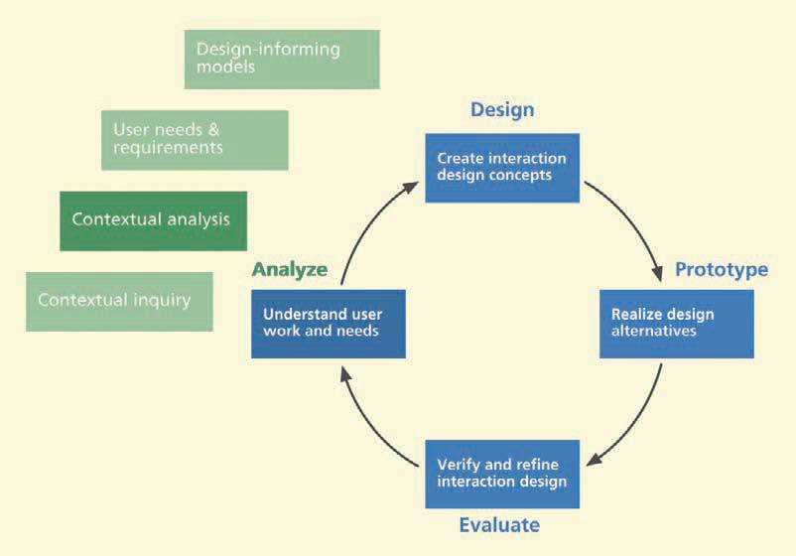

Slide 43
8.1 Contextual Analysis Is Data Interpretation
Since contextual analysis consists of user work activity data interpretation, consolidation, and communication.
▪ Interpretation of raw work activity data is accomplished
through:
– building a flow model
– synthesizing work activity notes
▪ Data consolidation and communication are accomplished
by, respectively:
– building a work activity affinity diagram (WAAD) from
the work activity notes
– walkthroughs of all these work products

Slide 44
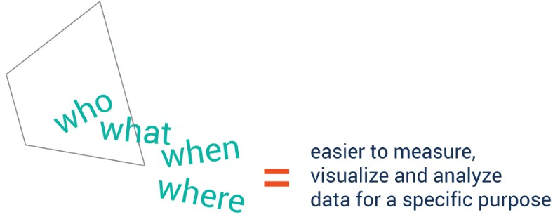

Slide 45
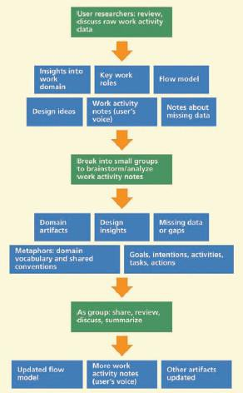
8.2
Overview
of
Data
Interpretation

Slide 46
Two important things about contextual analysis:
▪ Contextual analysis does not directly yield either requirements or design.
▪ You probably have to do much of your data interpretation separately for each of the work roles.

Slide 47
8.3Organizing Concepts:Work Roles And Flow Model
8.3.1 Managing Complexity with Work Roles and Flow
Models
▪ We need two things to help control the complexity and
wrap our heads around the problem:
– A big picture of the work domain, its components, and how information flows among them
– A way to divide the big picture into manageable pieces
▪ Because these two things are somewhat in opposition and
cannot be done by one single means, we need two
complementary concepts to solve the two parts of the
problem, respectively:
– A flow model to provide the big picture
– the concept of work roles as a basis to divide and conquer

Slide 48
8.3.2 Identify Work Roles as Early as Possible
▪ As Beyer and Holtzblatt (1998, p. 163) put it, a work role is a “collection of responsibilities that accomplish a coherent part of the work.”
▪ A given work role may or may not involve system usage
and some roles can be external to the organization, for
example, a parts vendor, as long as they participate in the
work practice of the organization.

Slide 49
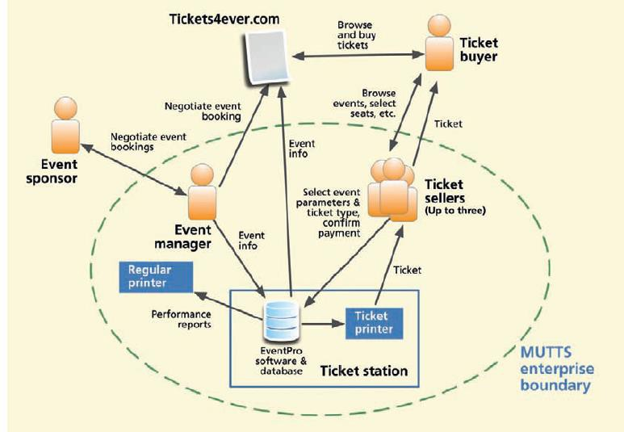
8.3.3 Start Sketching an Initial Flow Model
as Possible
▪ An initial flow model sketch of the MUTTS
as Early
system.

Slide 50
8.4 Creating And Managing Work Activity Notes
The main point of contextual analysis has two basic parts:
▪ Converting raw contextual data into work activity notes
▪ Converting work activity notes into a Work Activity
Affinity Diagram(WAAD)

Slide 51
8.4.1 Transcribing Interview and Observation Recordings
8.4.2 Reviewing Raw User Work Activity Data
• Recounting one interview at a time, researchers:
▪ Review interview and observation notes and any recorded audio
▪ Retell the events
▪ In discussion with the group, capture key points and issues,
design ideas, missing data, and questions course of the discussion
arising in the

Slide 52
•
User researchers talk about what users said and what they
observed that users did:
▪
Start with one big session to help everyone get going in the same direction, then break into groups to work in parallel.
▪
Choose groupings to give an approximate balance of group
size, background and skills, and distributing the user
researchers across the groups.
▪
A moderator in each group keeps things on track, while
user researchers give accounts of each interview. AND SO
ON ….

Slide 53
•
Finally the group engages in introspection about lessons
learned.
The group brainstorms to evaluate their process reflecting on what went well and what could be improved for next visit and how.
The outputs of this process of review and interpretation are:
•
•
▪
▪
Sets of work activity notes synthesized from raw data
A work activity affinity diagram to organize the work activity notes

Slide 54
8.4.3 Synthesizing Work Activity Notes
•
Because some application domains can be unfamiliar to
some team members, the work activity note synthesis should be done by people who have already been
immersed in the contextual data, probably the same people
who did the interviews and observations.
Guidelines for synthesizing work activity notes, starting here:
As you create each new work activity note, tag it with a
source ID, a unique identifier of the person being observed
and/or interviewed when the note was written.
•
▪

Slide 55
▪ Paraphrase and synthesize instead of quoting raw data text
verbatim.
For example:
Raw data: “I think of sports events as social events, so I like to go with my friends. The problem is that we often have to
sit in different places, so it is not as much fun. It would be better if we could sit together.”
In the user’s perspective: “When I am looking to buy student
tickets to MU basketball, I look for an option allowing
several friends to sit together.”

Slide 56
▪
Make each work activity note a simple declarative point
instead of quoting an interviewer’s question plus the user’s
answer.
Filter out all noise and fluff; make each note compact and concise, easily read and understood at a glance.
Be brief: Keep a note to one to three succinct sentences.
Each note should contain just one concept, idea, or fact,
▪
▪
▪
with possibly one rationale statement for it. Break a
work activity note into shorter work activity notes.
Make each note complete and self-standing.
long
▪

Slide 57
▪ Never use an indefinite pronoun, such as “this,” “it,”
“they,” or “them” unless its referent has already been
identified in the same note.
▪ State the work role that a person represents rather than
using “he” or “she.”
▪ Add words to disambiguate and explain references to
pronouns or other context dependencies.
▪ Avoid repetition of the same information in multiple places.

Slide 58
Example: Work Activity Note Synthesis for MUTTS
▪ User comment (in response to thinking ahead about including athletic events):
When I am looking to buy student tickets to MU basketball, like to look at different seating options vs. prices; I sometimes look for an option allowing several friends to sit together.
▪ Synthesized work activity notes:
When I am looking to buy student tickets to MU basketball,
I
I
like to look at different seating options vs. prices. When I am
looking to buy student tickets to MU basketball, I sometimes look for an option allowing several friends to sit together.

Slide 59
8.4.4 Extending the Anticipated Data Bins to
Accommodate Your Work Activity Note Categories
Examples of typical data categories you might encounter
your raw data are:
▪ User and user class information
in
▪ Social aspects of work practice (how people interact with
and influence each other)
▪ Emotional impact and long-term phenomenological aspects
▪ Task-specific information
▪ Physical work environment
▪ Design inspiration ideas

Slide 60
8.5 Constructing Your Work Activity Affinity
Diagram (WAAD)
Introduction to WAAD Building
Affinity diagramming is a technique for organizing and
grouping the issues and insights across all users in your
contextual data and showing
it in a visual
room.
display
that
can
cover
one
or
more
walls
of
a

Slide 61
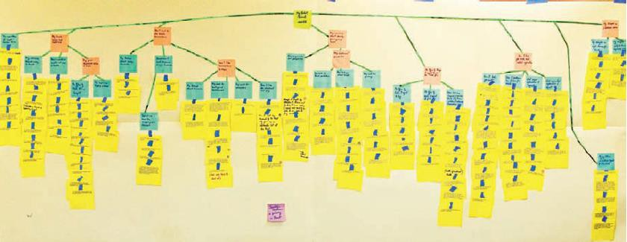
Example: WAAD Building for MUTTS
you can see a photo
of
a
large
part
of
the
overall
WAAD
we
built
for
MUTTS.

Slide 62
8.6 Abridged Contextual Analysis
Process
8.6.1 Plan Ahead during Contextual
One Idea per Note
Inquiry by Capturing
▪ The idea is to produce work activity
notes without the
laborious and voluminous intervening raw data transcripts.
▪ Experienced practitioners, skilled at note taking and abstracting the essence, can do some of this abstraction of detail from the real-time flow of raw data during the interviews themselves.

Slide 63
8.6.2 Focus on the Essence of WAAD Building
▪
The WAAD-building process itself can also be abridged by
creating clusters of all the work activity data notes without building a hierarchical abstraction of the different categories.
As you get through the part of the process where you put all the work activity notes on the wall to represent the affinities as clusters, you get a sense of the key themes and issues in the work domain.
Using the temporary labels and walking through the clusters, you can immediately start creating a list of high- level requirements for the system.
▪
▪

Slide 64
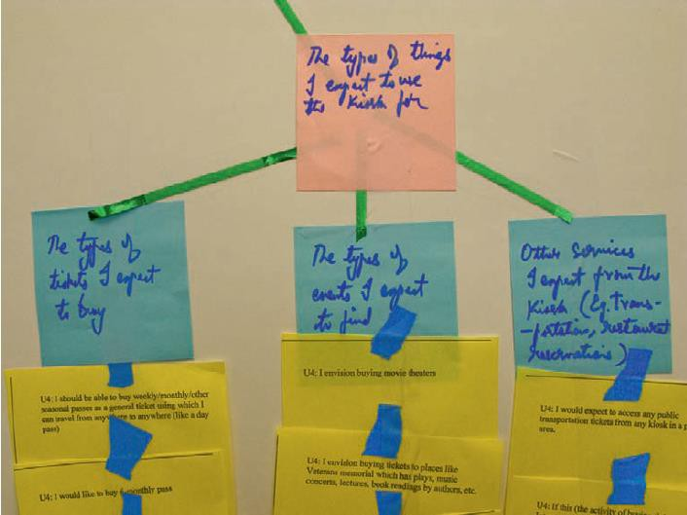
Example
:
A
close-up
of
the
MUTTS WAAD.

Slide 65
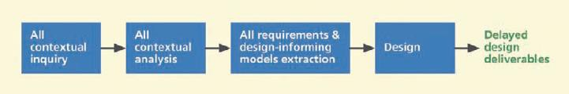
8.6.3 Use Finer-Grained
Iteration
to
Address
Pressure
for
Early
Deliverables
▪ Doing a full contextual inquiry and requirements extraction
process upfront means a large investment in each stage before proceeding to the next and delayed design deliverables, causing conflict with an anxious manager or customer.

Slide 66
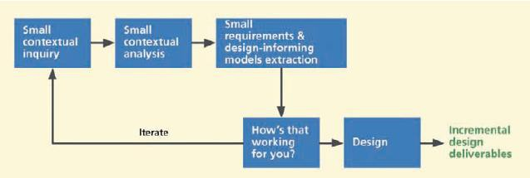
▪ An incremental investment in smaller and more frequent
iterations is well suited for this common situation, as shown in Figure below Do a little contextual inquiry, a little contextual analysis, a little requirements
extraction and a little design and then get some
feedback
from
users
about
whether
you
are
on
course.

Slide 67
8.6.4 History Of Affinity Diagrams
▪
Historically, affinity diagramming has been used as an
effective method for generating hierarchical categories to organize large amounts of unstructured, far-ranging, and seemingly dissimilar qualitative data about almost anything.
As Wood (2007) says, “This process exposes and makes concrete common issues, distinctions, work patterns, and needs without losing individual variation.”
The affinity diagram has been called one of the most significant management and planning tools in business and has been used to organize many different kinds of ideas in brainstorming and qualitative data in studies.
▪
▪

Slide 68
9.
Extracting Interaction
Requirements
Design

Slide 69
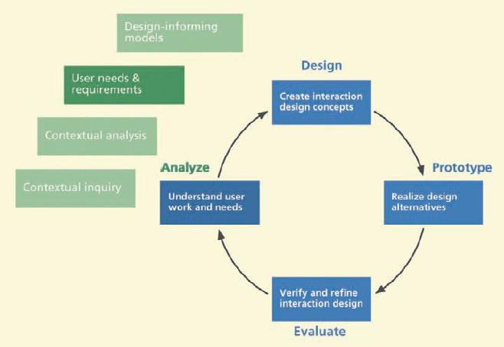
9.1 Introduction
9.1.1 You are here
▪ the chapter on extracting interaction requirements, within
understanding
user work and needs
in the
context
of
the
overall
Wheel
lifecycle
template.

Slide 70
9.3 Formal Requirements Extraction
▪ This process of extracting needs and requirements is
similar to data interpretation and consolidation sessions of contextual analysis in that it involves a group sitting down together and going over a large amount of data, including the WAAD and evolving design-informing models.
▪ But here it is actually easier because much of the hard work is already done.

Slide 71
10. Constructing Design
Informing
models

Slide 72
10.4 User Models
▪ User models are a set of models that define who the users
are, including everything about work roles, sub-roles,
class definitions, and personas.
▪ Perhaps the most important of the design-informing
user
models
are
the
user
models
and
the
usage
models.

Slide 73
10.5
Usage Models
▪ Usage models are a set of models that define how work
gets done, including
▪ Flow models
▪ Task structure models
▪ Task interaction models.

